Slide 1
Mathematical modelling of target road trajectory by polynomial curve fitting algorithm in MATLAB

Slide 2
Project background
Road geometry
Mathematical describing

Slide 3
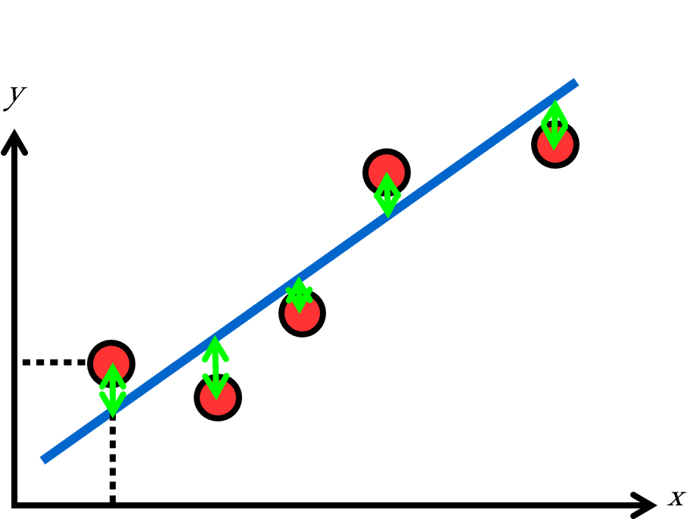
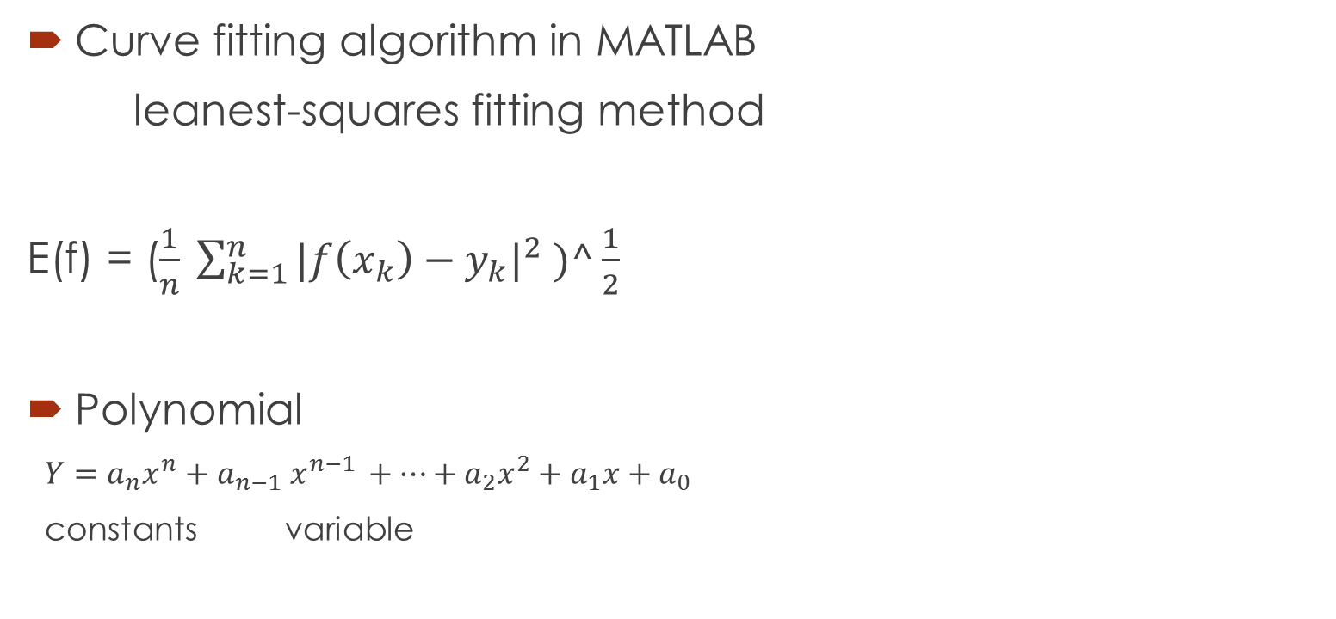
Project context
Curve fitting algorithm in MATLAB
leanest-squares fitting method
E(f) = ($\frac{1}{n} \sum_{k=1}^{n}{{|f\left(x_{k}\right)−y_{k}|}^{2} )^\frac{1}{2}}$
Polynomial
$Y=a_{n}x^{n}+a_{n−1} x^{n−1 }+…+a_{2}x^{2}+a_{1}x+a_{0}$
constants variable

Slide 4
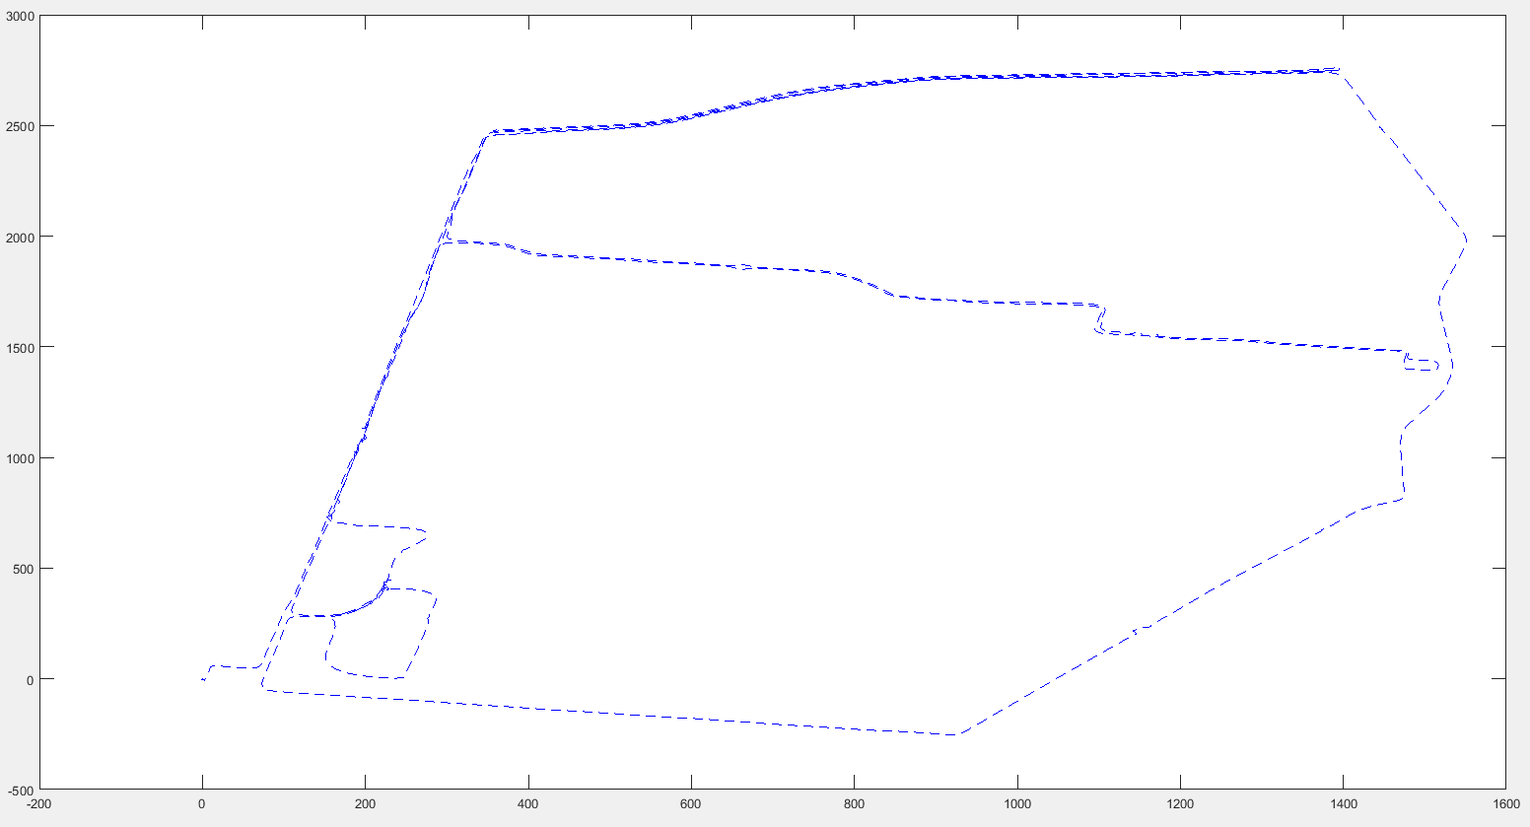
Target road

Slide 5
Purpose
Build mathematical model for the target road
Evaluate the performance of polynomial fitting in road route
Give a low-cost methodology for mathematical modelling in road route

Slide 6
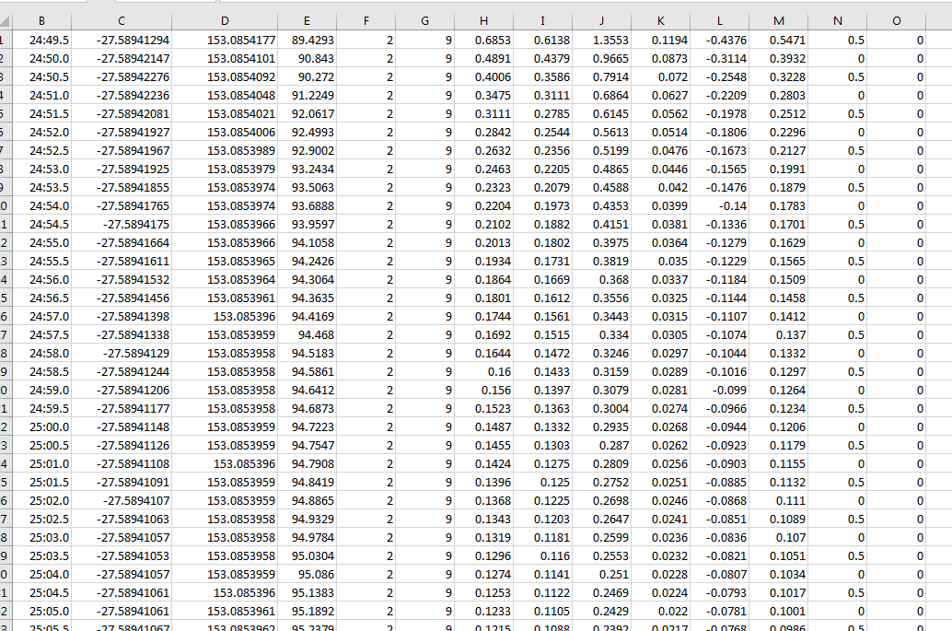
Overall method
high-precise GPS receiver to collect the target road data

Slide 7
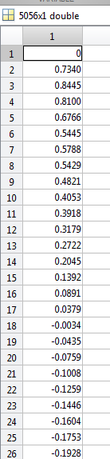
Overall method
Convert longitude and latitude value to meters and Create local 2D coordinate for target road
latitude = xlsread('rtk1.xlsx','C1:C5056');
longitude = xlsread('rtk1.xlsx','D1:D5056');
longitude_meter_all = (longitude-longitude(1)).*111111;
latitude_meter_all = (latitude - latitude(1)).*111111.*cos(latitude);

Slide 8
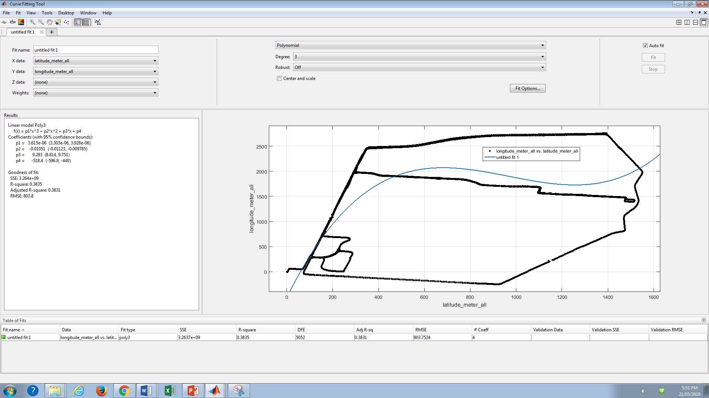

Slide 9
Overall method
Divide target road to different part: zoom method
Construct polynomial model for each part of road
[xData, yData] = prepareCurveData( latitude_meters{1}, longitude_meters{1});
ft = fittype( 'poly4' );
[fitresult{1}, gof(1)] = fit( xData, yData, ft )
Evaluate all the polynomial models accuracy

Slide 10
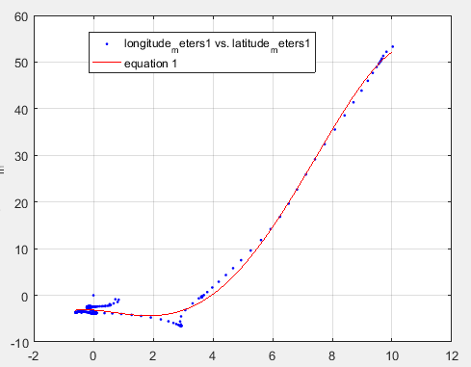
Typical polynomial equation
when x is (0,10), poly4
Fitresult(1) = p1*x^4 + p2*x^3 + p3*x^2 + p4*x + p5
Coefficients :
p1 = -0.01911
p2 = 0.3131
p3 = -0.6219
p4 = -0.4488
p5 = -3.175
Errors = 1.0715 meters

Slide 11
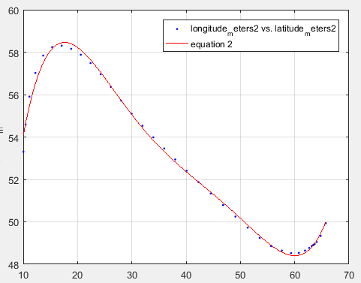
Typical polynomial equation
when x is (10,66), poly5
fitresult2(x) = p1*x^5 + p2*x^4 + p3*x^3 + p4*x^2 + p5*x + p6
Coefficients :
p1 = 6.471e-07
p2 = -0.0001296
p3 = 0.01006
p4 = -0.3746
p5 = 6.356
p6 = 19.12
Errors = 0.2199 meters

Slide 12
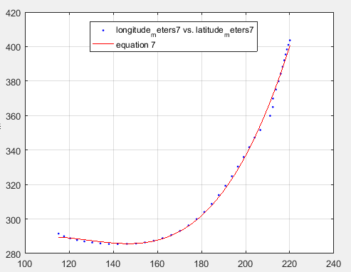
Typical polynomial equation
When x = (115, 220)
Linear model Poly3:
fitresult7(x) = p1*x^3 + p2*x^2 + p3*x + p4
Coefficients :
p1 = 0.0001675
p2 = -0.06467
p3 = 8.158
p4 = -48.18
Errors: 2.3211 meters

Slide 13
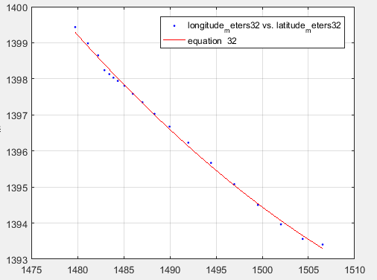
Best case
when x is (1506.5, 1479.8)
Linear model Poly2:
fitresult(32) = p1*x^2 + p2*x + p3
Coefficients :
p1 = 0.00236
p2 = -7.272
p3 = 6992
Errors = 0.0977 meters

Slide 14
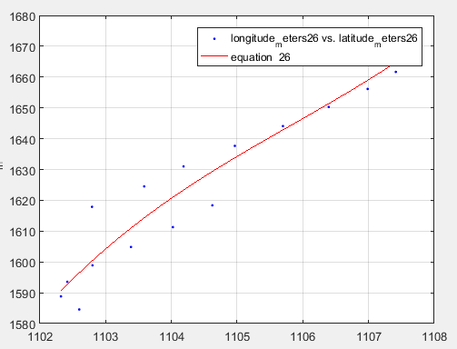
Worst case
When x is (1102, 1108)
Linear model Poly1:
fitresult(26) = p1*x + p2
Coefficients :
p1 = 14.79
p2 = -1.471e+04
Errors: 10.3106 meters

Slide 15
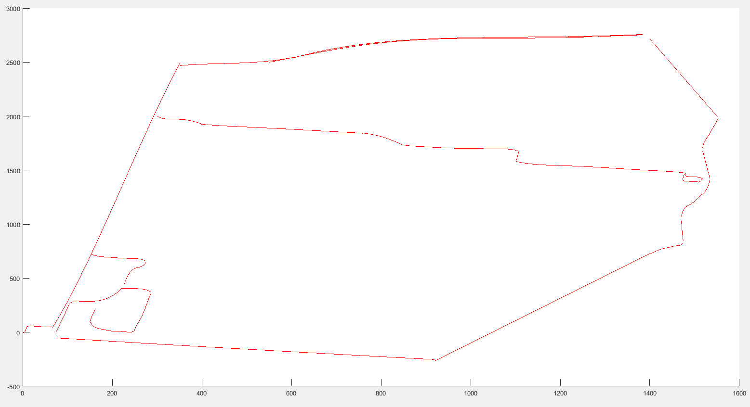
Deliverables
36 polynomial equation: average errors = 2.7498 metters

Slide 16
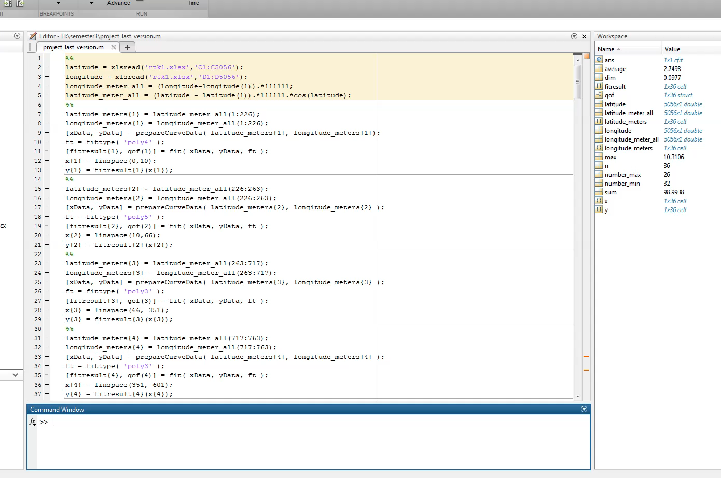

Slide 17
Benefit
Easy to understand
Simplified represent
Only need several parameters

Slide 18
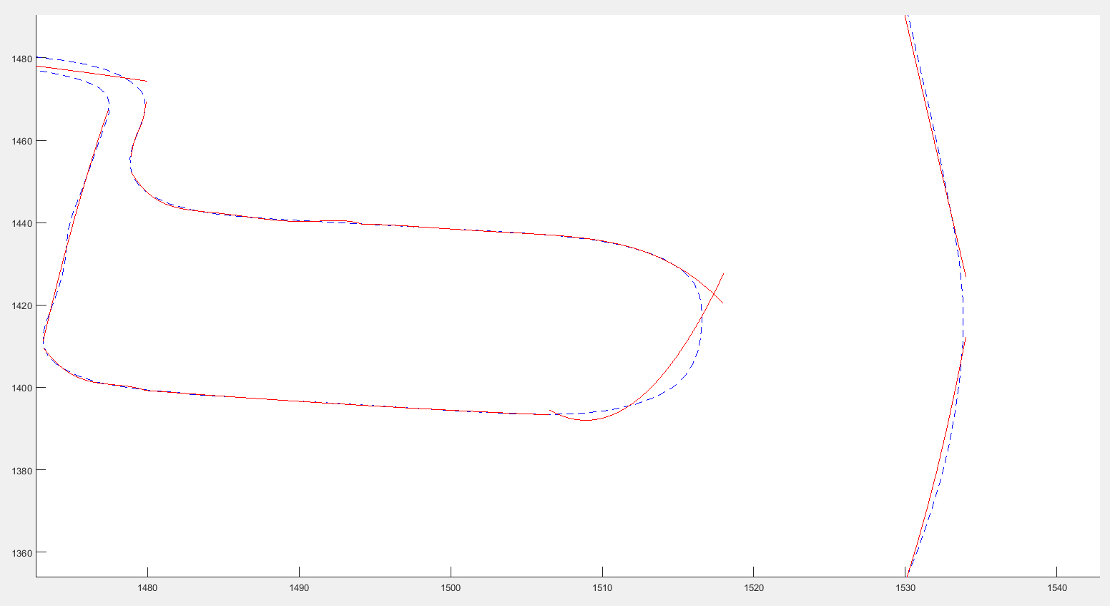
Disadvantage

Slide 19
Disadvantages
a big radian curve
Concatenation errors

Slide 20
implications
Map industry
Autonomous vehicle technology

